Slide 1

Restaurant Operations Capstone
Kelly Harrington

Slide 2
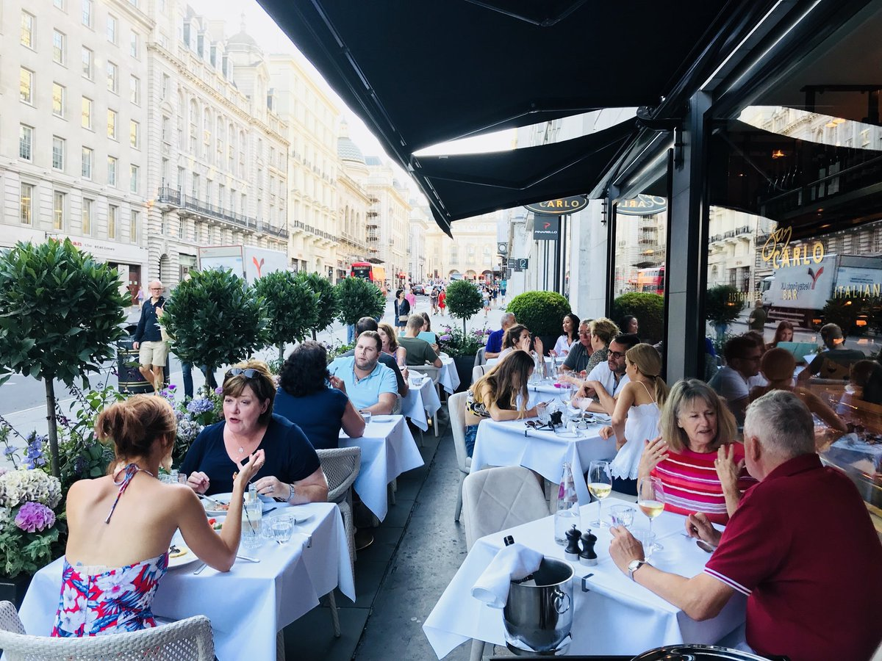
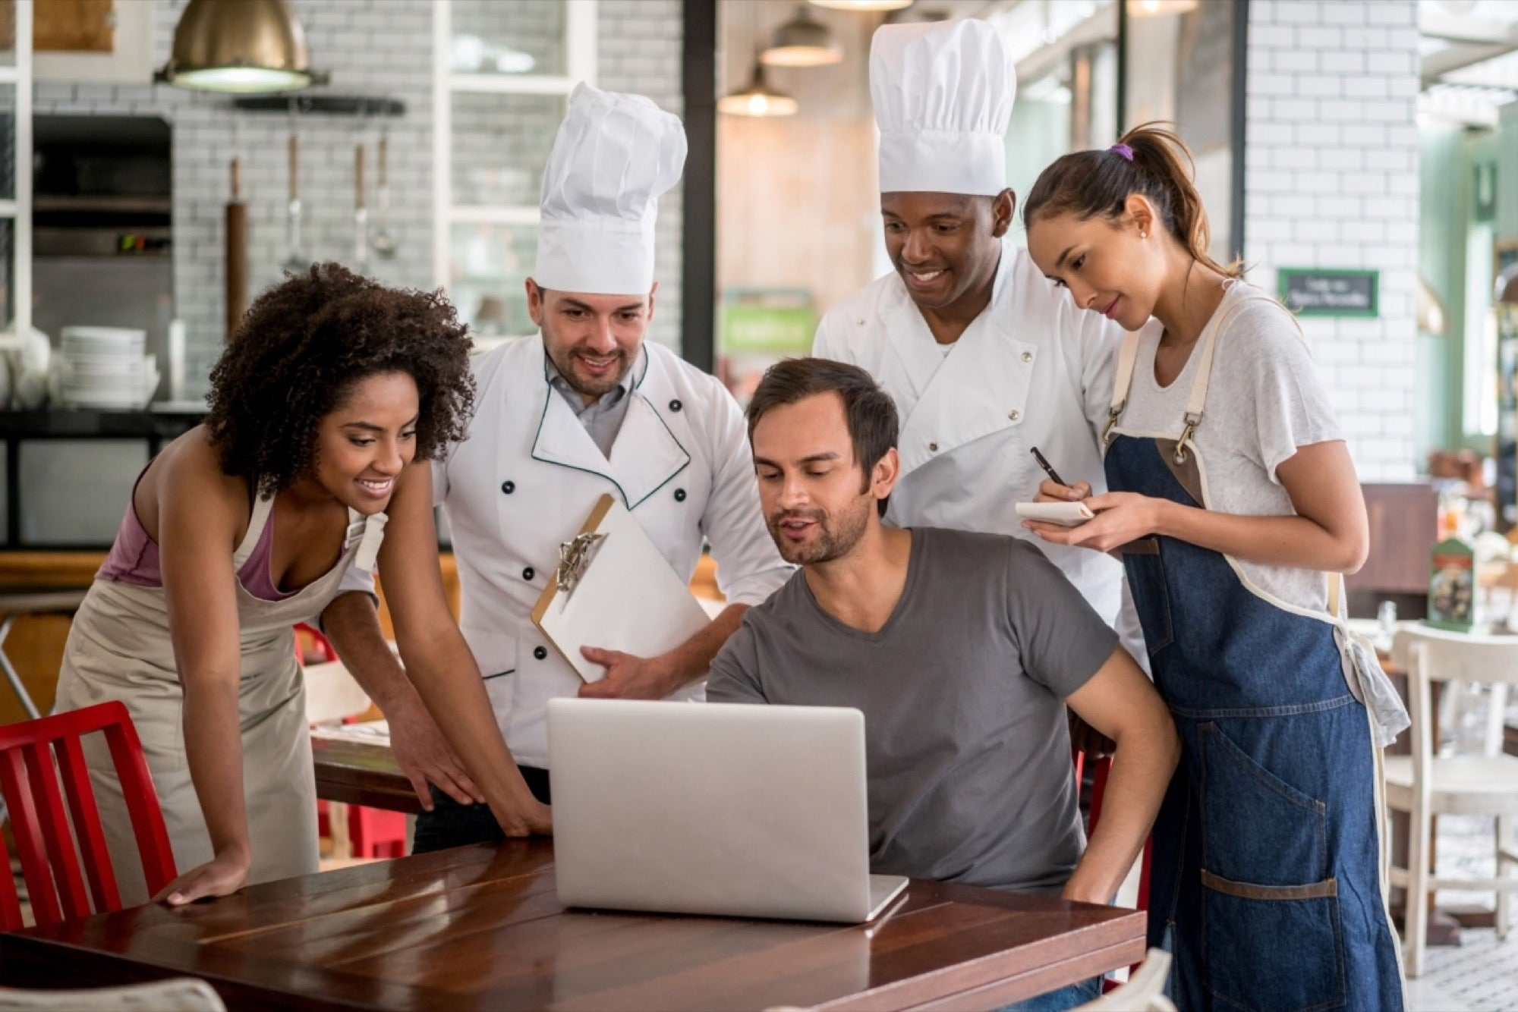
Behind the Scenes

Slide 3
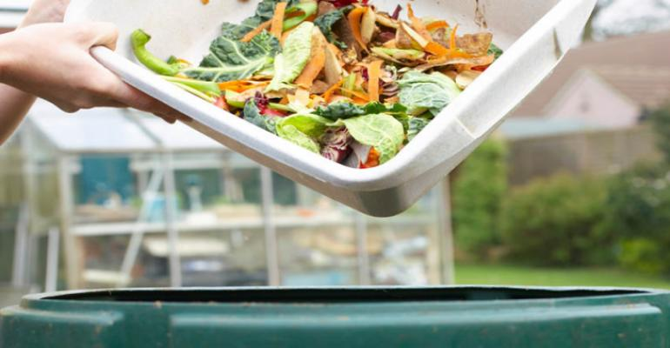
Back of House Problems: Ordering
Varies from restaurant to restaurant
Varies within a restaurant
Running out of items
Food waste
High overhead
Notes:
Tried to order something at a restaurant and they are out
Worked at a restaurant and had to explain to a customer that there wasn’t a certain product

Slide 4
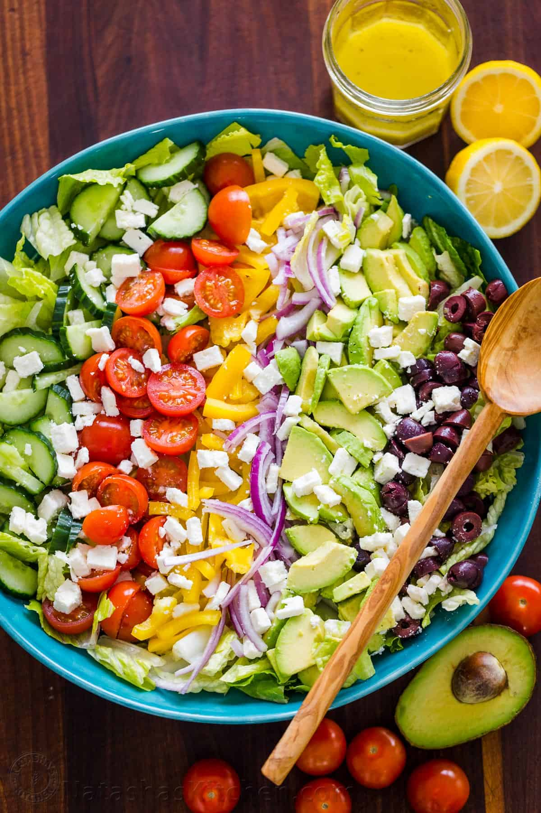
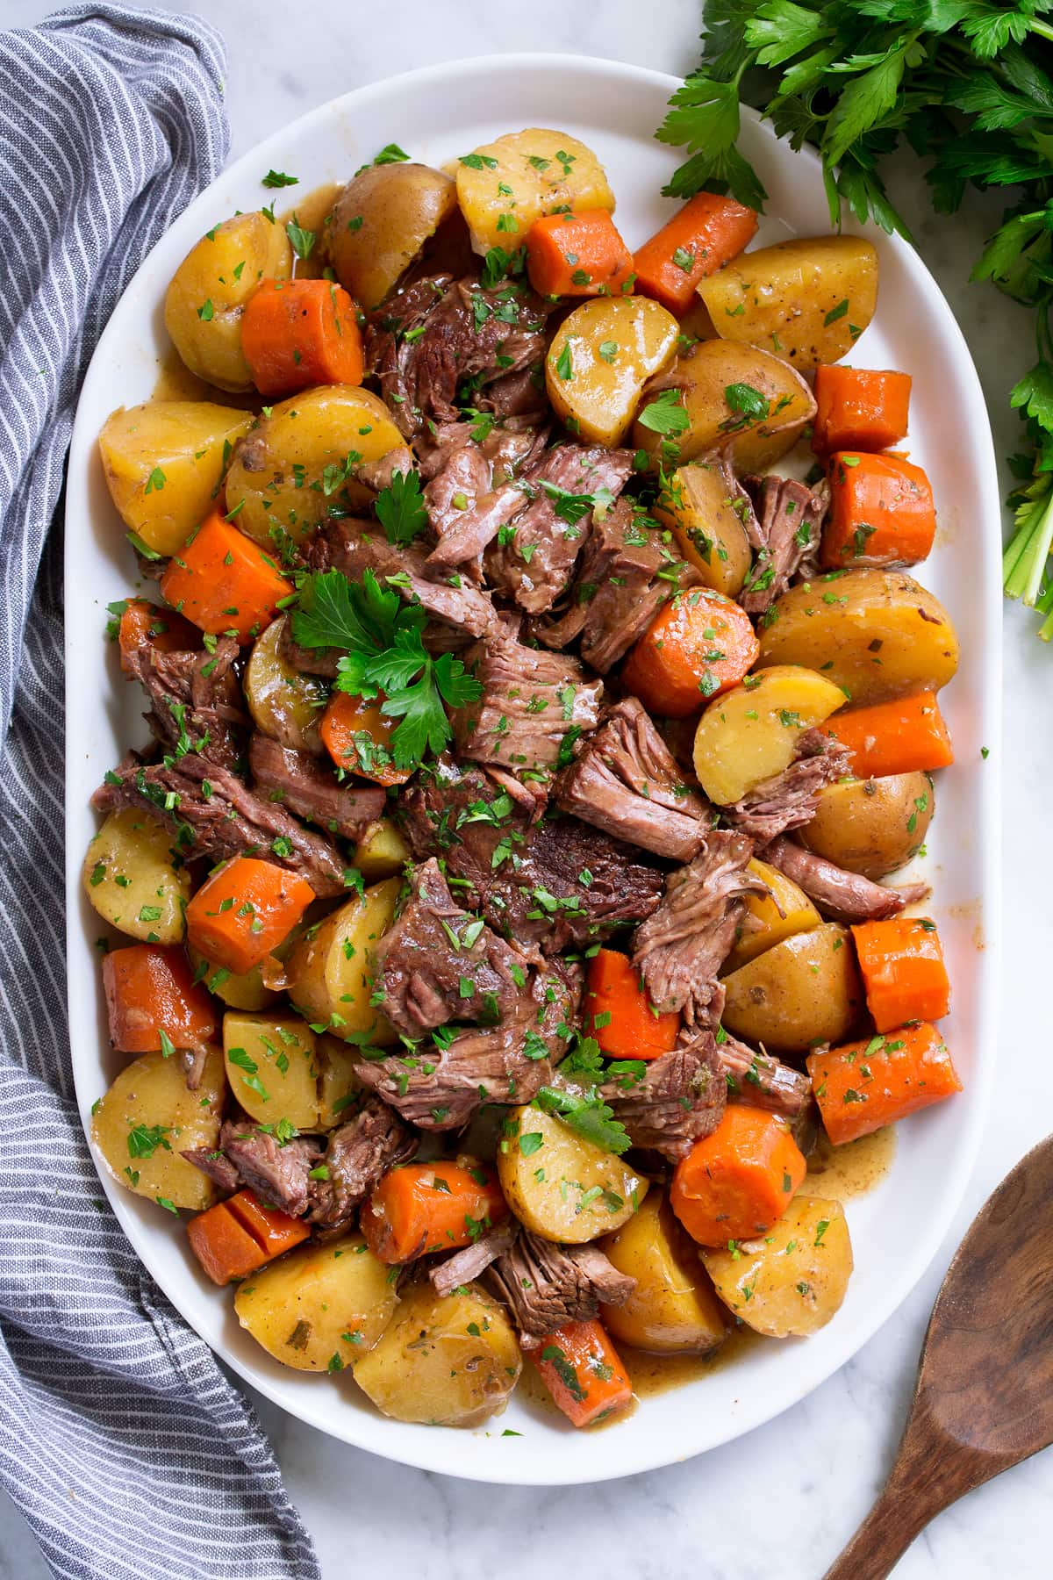
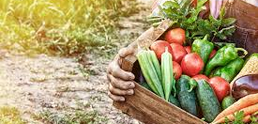
Other ordering issues
Seasonality
Inexperienced managers
Farm to Table Freshness

Slide 5
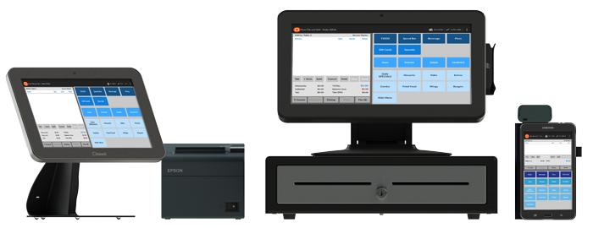
Toast

Slide 6
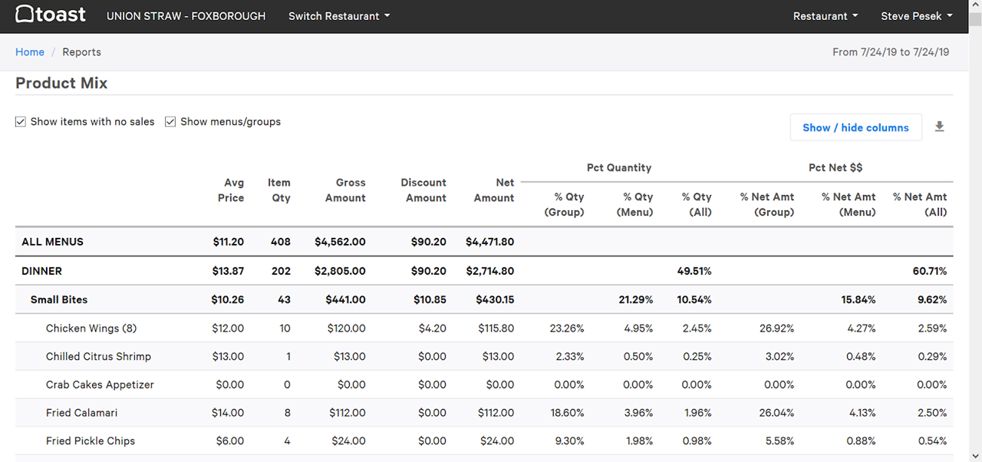
Toast’s Dataframes

Slide 7
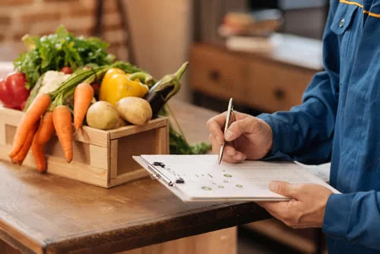
Disadvantages
Lacks daily insights
No predictive element to help ordering
Product insights and ordering guide
Solution

Slide 8
Modeling Restaurant Data
Download & obtain data
Visualize
Cleaning
Feature engineering
Feature selection
Model training
Prediction

Slide 9
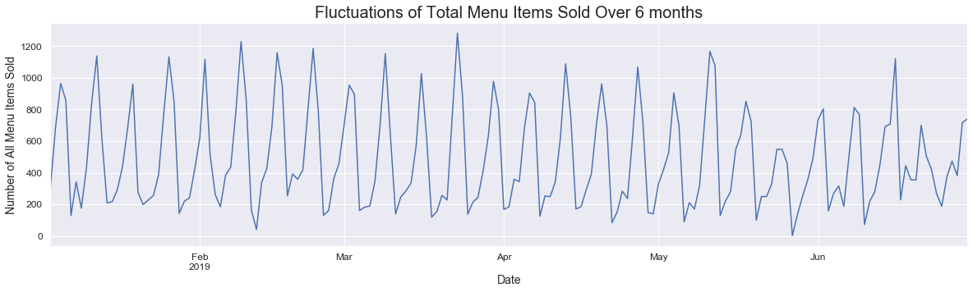
Obtain | Explore | Visualize

Slide 10
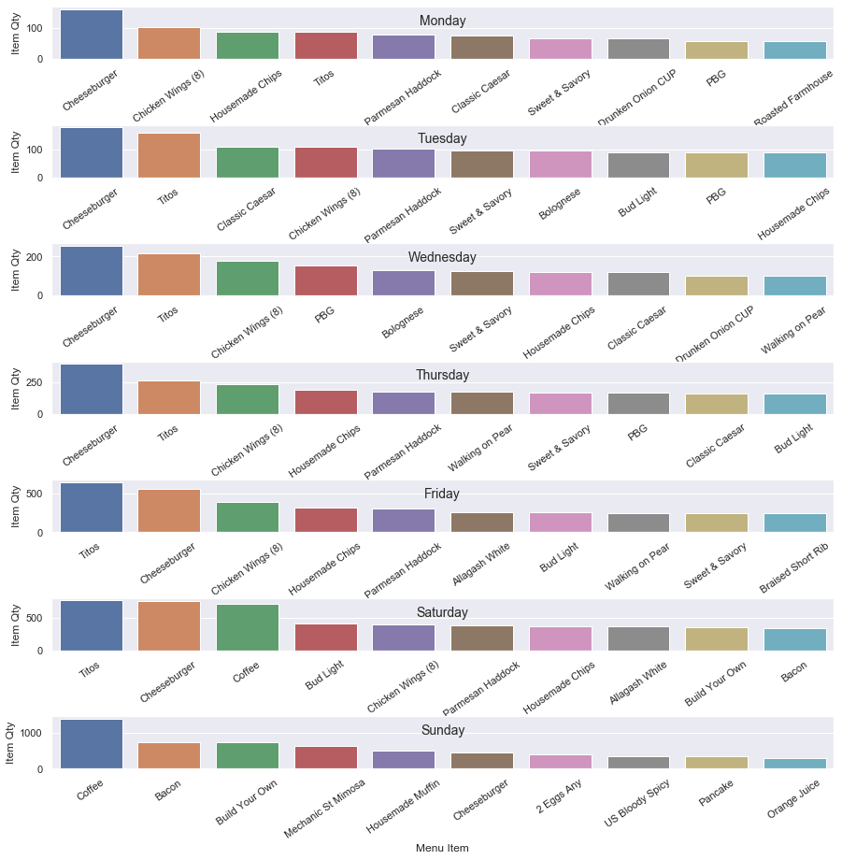

Slide 13
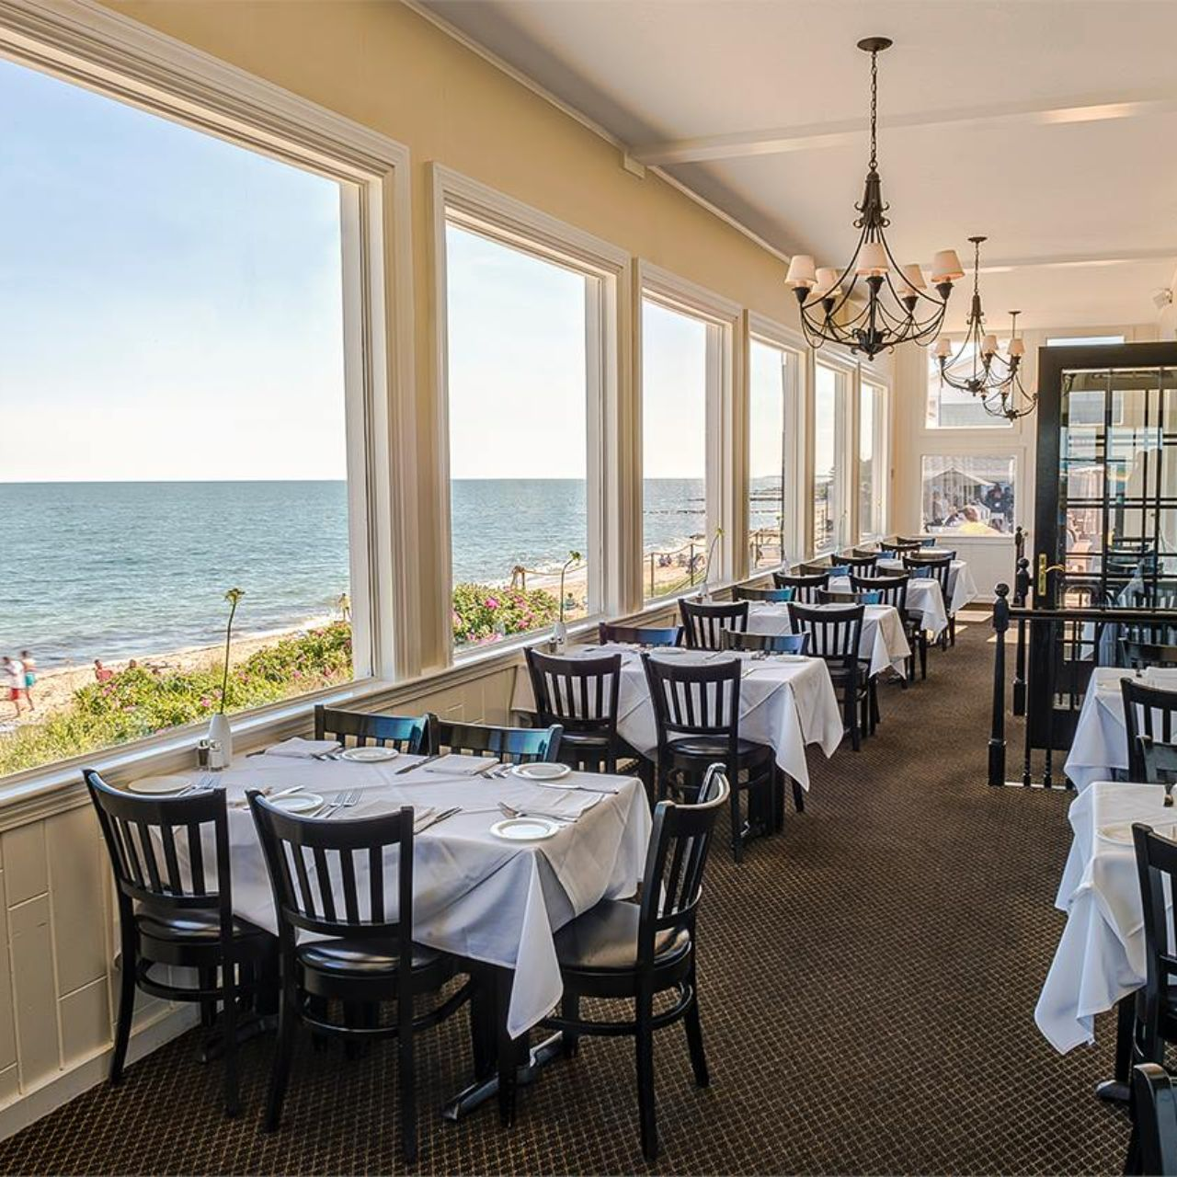
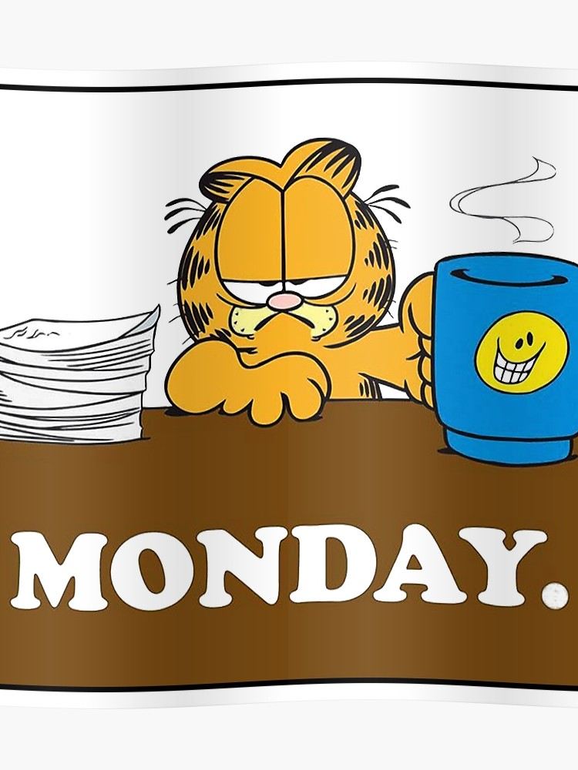

Modeling Burgers
Most consistently ordered item
What factors could affect ordering a burger?
Guests
Day of the week
Month of the year
Weather

Slide 14
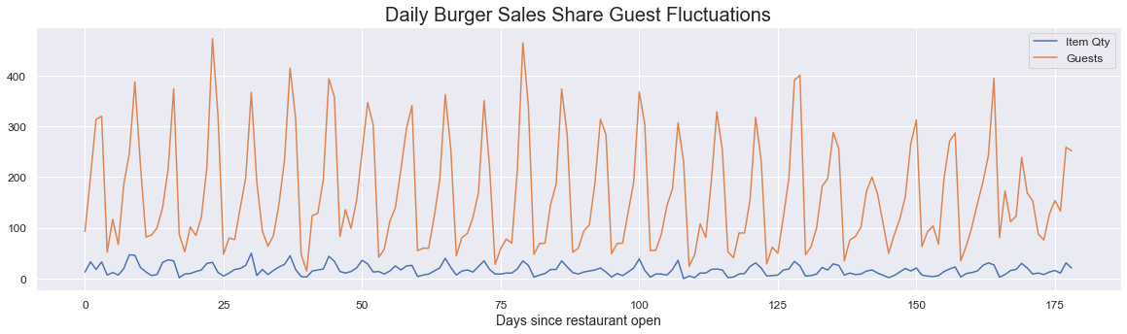

Slide 15
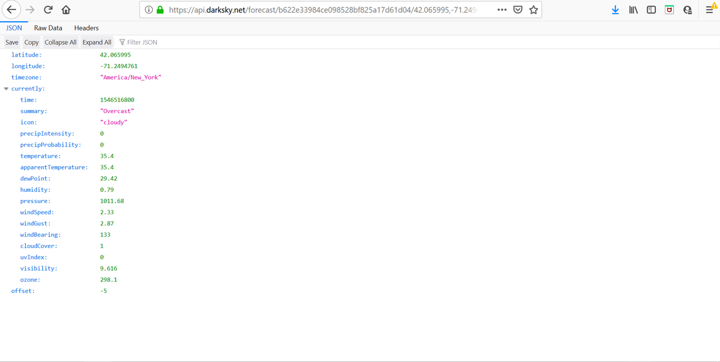
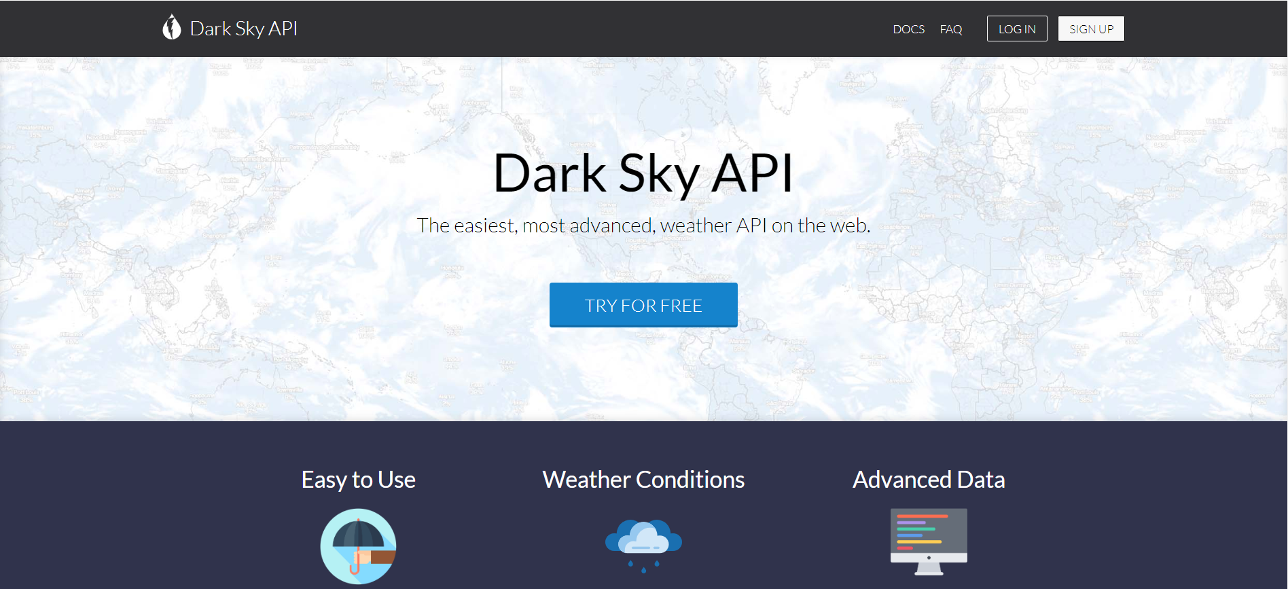

Slide 16
Toast
Dark Sky
Engineered
Guests
Apparent Temperature
Cloud cover
Dewpoint
Humidity
Icon
Ozone
Precipitation Intensity
Precipitation Probability
Pressure
Summary
Temperature
UV Index
Visibility
Wind Bearing
Wind Gust
Wind Speed
Day of the week
Day since open
Menu Item
Hours open per Day of the week
Menu Group
Month
Item Qty
Cheeseburger
Date*
Probability on the DOTW last week
Probability on the DOTW / Month
Number ordered per DOTW
Number ordered per DOTW per month
Guest group
Probability of ordering grouped by category
Guest group probability * Probability ave
Notes:
January different

Slide 17
Models Evaluated
Linear Regression
Huber Regression
Ridge Regression
Gradient Boost
Random Forest
XGBoost
Linear Regression
R²= 0.807
Stdev= 0.084
Huber Regression
R²= 0.801
Stdev= 0.076
Ridge Regression
R² = 0.801
Stdev: 0.083
Gradient Boost
R² = 0.718
Stdev: 0.101
Gradient Boost
R² = 0.721
Stdev: 0.136
XGBoost
R² = 0.718
Stdev: 0.136

Slide 18
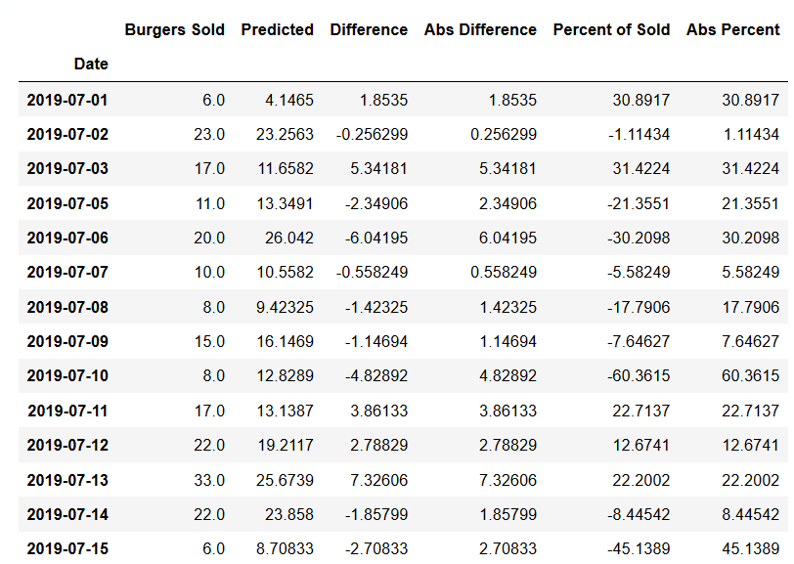
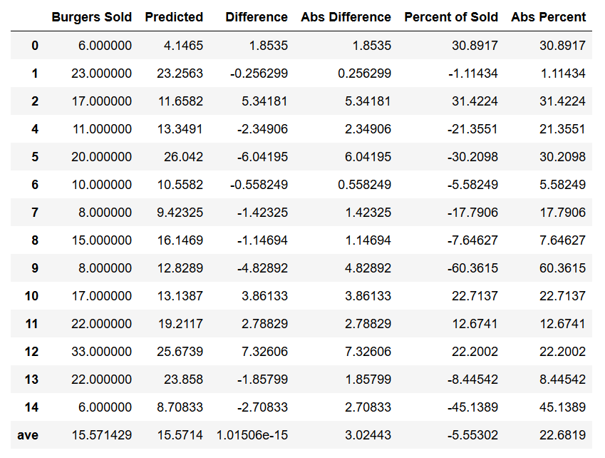
Prediction

Slide 19
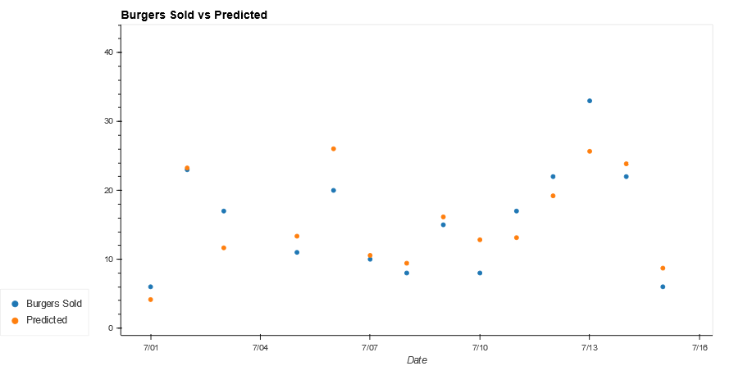
Predictions

Slide 20
Future Implications
Reduce labor
Reduce food waste
Save restaurants money
Dictate specials & increase profits
Provide Guests with fresher product
Automatic ordering

